Slide 1
Topic: Changing paradigm
Dr. C. Vijaya Banu
Professor , School of Management
SASTRA Deemed University, Thanjavur – 613 401
vijayabanu@mba.sastra.edu

Slide 2
The Changing Paradigm of Management
A paradigm is a shared mind-set that represents a fundamental way of thinking about, perceiving, and understanding the world.
Shifts in ways of thinking are occurring in our society, and these in turn impact organizations, causing shifts in management thinking and behaviour.
The primary shift is from the traditional vertical organization to something called the learning organization.

Slide 3
Vertical Organization
• one in which activities are grouped by common function from the bottom to the top of the organization. The whole organization is coordinated and controlled through the vertical hierarchy, with decision-making authority residing with upper-level managers.
• characterized by routine, specialized jobs and standardized control procedures. • very effective in stable times. However, they often do not work well in fast-changing environments. In response, many companies are shifting to a new paradigm and becoming organizations.

Slide 4
Learning Organization
- • the primary responsibility of the managers is not to make decisions, but to create learning capability throughout the organization. Employees on the front lines routinely make decisions rather than passing them up the hierarchy for approval.
• there is no single model of the learning organization; it is a philosophy or attitude about what an organization is and the role of employees. • everyone in the organizations participates in identifying and solving problems, enabling the organization to continuously experiment, improve, and increase its capability
The Fifth Discipline: The Art and Practice of the Learning Organization is a book by Peter Senge (1990)

Slide 5
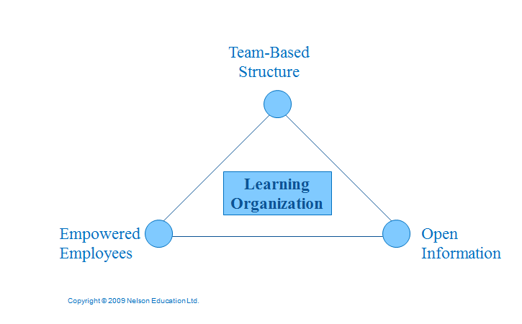
Elements of a Learning Organization

Slide 6
New orgnisations
The traditional top-down hierarchy is giving way to flatter organizations to built around self directed teams collaborating across levels and departments. Lower-level managers serve as team leaders, coaches and facilitators

Slide 7
How is the manager’s job changing?

Slide 8
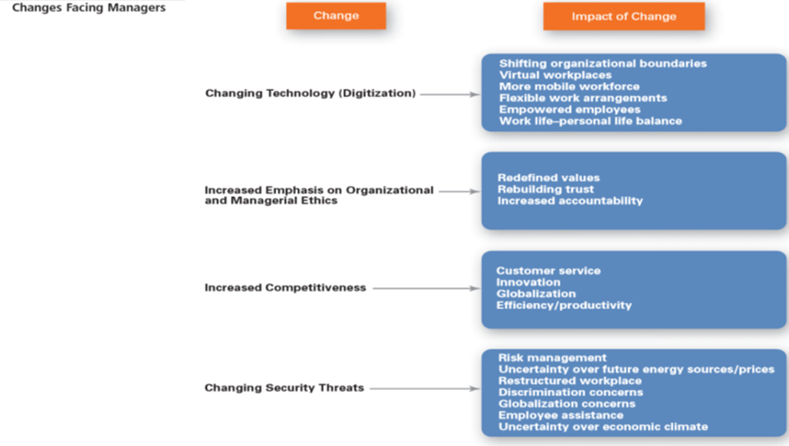

Slide 9
Management and the New Workplace
Digitalisation
Ethics
Competition
Security threats
Centred around information and ideas.
Work is free-flowing and flexible.
Organized around networks, work is often virtual.

Slide 10
New Management Competencies
Embrace ambiguity
Create organizations that are:
Fast
Flexible
Adaptable
Relationship oriented
Focus on:
Dispersion of leadership
Staying connected to employees and customers
Team building
Developing a learning organization

Slide 11
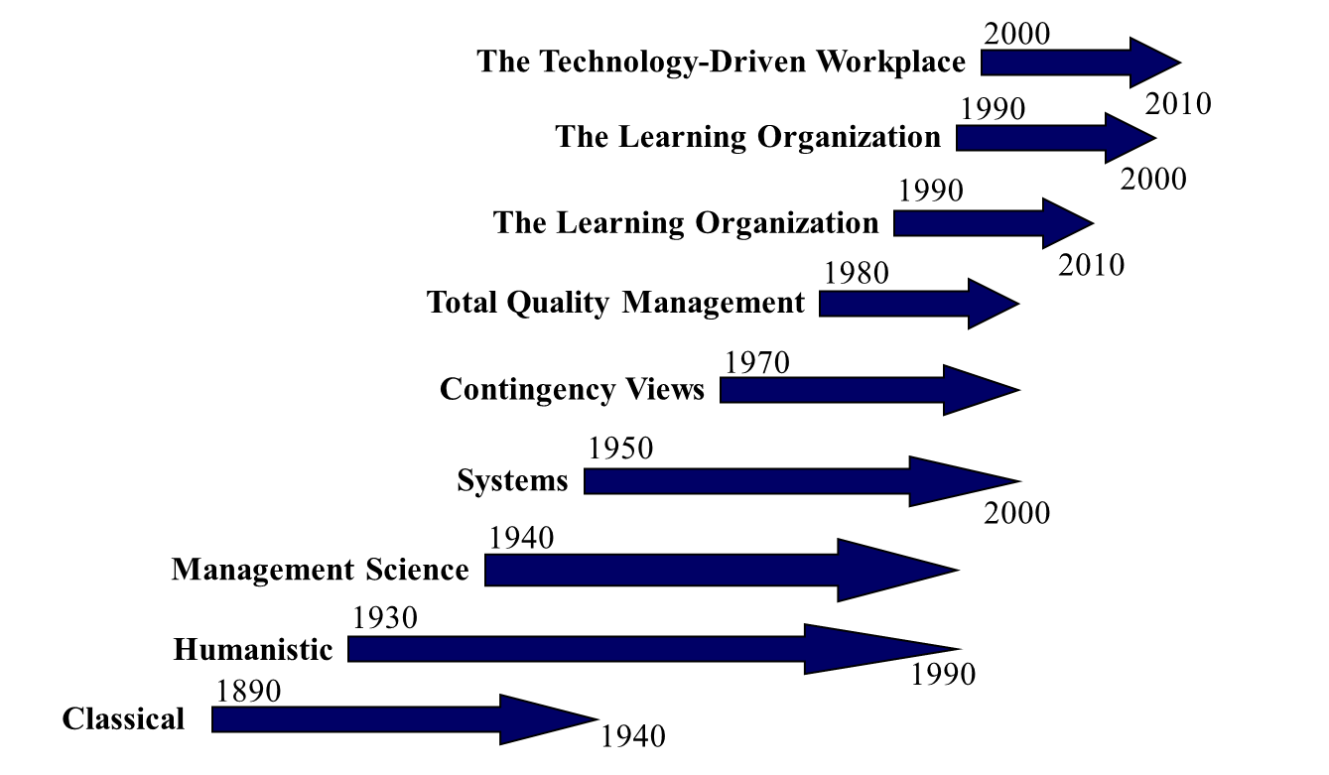
Management Perspectives Over Time

Slide 12
Organization as an Open System

Slide 13
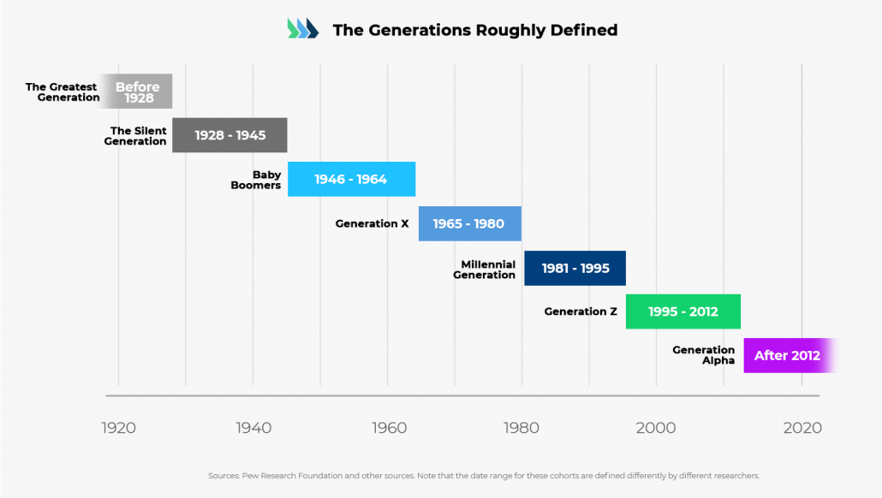
Different generations

Slide 17
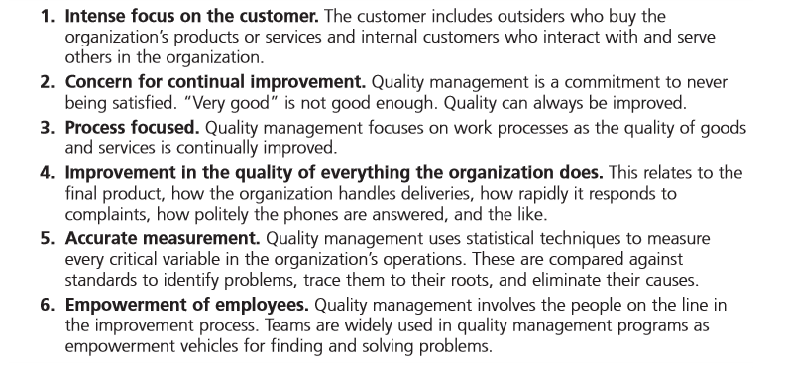
What Is Quality Management?
Source : OB/Management-11th-edn-by-Stephen-P-Robbins-Mary-Coulter

Slide 18
Rewards and Challenges of Being a Manager
Source : OB/Management-11th-edn-by-Stephen-P-Robbins-Mary-Coulter

Slide 19
Benefits of Workforce Diversity
Source : OB/Management-11th-edn-by-Stephen-P-Robbins-Mary-Coulter

Slide 24
https://www.slideshare.net/IbadatSingh/contemporary-challenges-in-management

